Slide 1
TIC TAC TOE
A HOUSEHOLD GAME

Slide 2
Presented By:
Abhishek Sarkar
Debojyoti Dey
Sk Shahir Halim

Slide 3
Contents
Three choices:
Player VS Computer
Computer VS Player
Multiplayer
Algorithm
Implementation
Credits

Slide 4
Algorithm
Some Considerations:-
The grid of tic tac toe game is basically a 3X3 matrix
Internally all the cells are initialized by an arbitrary number (say 5) which denotes to be vacant.
Cross ‘X’ is internally taken as 1 and Zero ‘0’ by itself.
Player’s (1st player in case of multiplayer) input is represented by ‘X’
Computer’s (2nd player in case of multiplayer) input is represented by ‘0’.
Rest of the rules are as per the basic game rule.

Slide 5
Player VS Computer
The player will start the game, hence he can get maximum 5 chances (5 iterations needed).
Every time an iteration begins, current situation of the game is printed.
Then it is checked whether diagonally/horizontally/vertically there are three consecutive 0’s, If there is, then computer wins else user is allowed to give an input.
Game won’t proceed until valid position of input is given by player.
After player input, it is checked whether diagonally/horizontally/vertically there are three consecutive 1’s.
If there is, then player wins, else if it was the last chance to the player then it is a Draw Match, & game ENDS!!!
If this was 1st chance to player
  If the center position is not empty then top left is made 0 by Computer else center is made 0.

Slide 6
Player VS Computer
Else
  If in any linear order there is two 0’s and the remaining one place is empty, it is made zero.
  Else if any linear order there is two 1’s and the remaining one place is empty, it is made zero.
  Else if it is 2nd iteration & extreme diagonal elements are 1 and center is zero, middle-left is made 0.
  Else
    If 2nd row/column is totally empty excluding center, left/top position is made 0 respectively.
    Else if 2nd row/column is having 0, 1, and an empty space, it is made 0.
A complete iteration ends here and repeats same logic until 5 iterations are done or anyone wins.

Slide 7
Computer VS Player
Computer will start the game, hence it will get maximum 5 chances (5 iterations needed).
If this is the 1st iteration, then either top left or center is made 0 (randomly chosen) by computer.
Else if it 2nd iteration, then either top-left/bottom-right whichever is empty is made 0, else top right is made 0.
Else
  If in any linear order there is two 0’s and the remaining one place is empty, it is made zero.
  Else if any linear order there is two 1’s and the remaining one place is empty, it is made zero.
  Else if it is 3rd iteration, bottom left is made 0.
  Else
    If 2nd row/column is totally empty excluding center, left/top position is made 0 respectively.

Slide 8
Computer VS Player
    Else if 2nd row/column/minor diagonal is having 0, 1, and an empty space, it is made 0.
Current situation of the game is printed.
Then it is checked whether diagonally/horizontally/vertically there are three consecutive 0’s, If there is, then computer wins else if it was 5th iteration, it’s a draw match & GAME ENDS!!! Else player is allowed to give input.
Game won’t proceed until valid position of input is given by player.
After player input, it is checked whether diagonally/horizontally/vertically there are three consecutive 1’s.
If there is, then player wins & Game ENDS!!!
A complete iteration ends here and repeats same logic until 5 iterations are done or anyone wins.

Slide 9
Multiplayer
Names of both the players are entered.
1st player starts the game and turns are alternate to both the players, hence 9 iterations needed.
Every time an iteration begins, current situation of the game is printed.
Corresponding player is allowed to give the input.
Game won’t proceed until valid position of input is given by player.
Then it is checked whether the corresponding player wins by present situation by any linear order, if it is then he is declared to have won, Else if it is the 9th iteration, it is a draw match, & game ENDS!!!
A complete iteration ends here and repeats same logic until 5 iterations are done or anyone wins.

Slide 10


Implementation

Slide 11
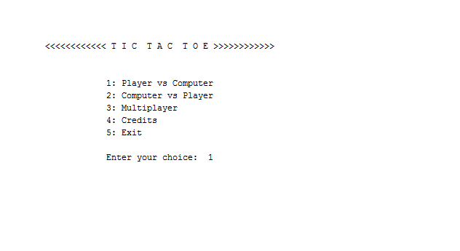
Screenshots of Player vs Computer

Slide 12
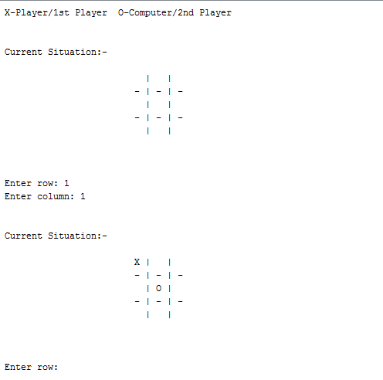
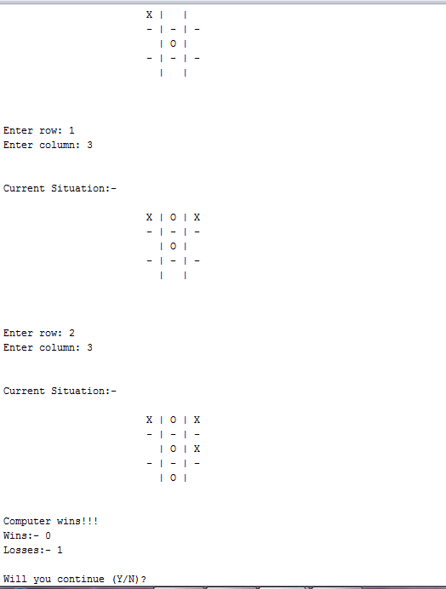

Slide 13
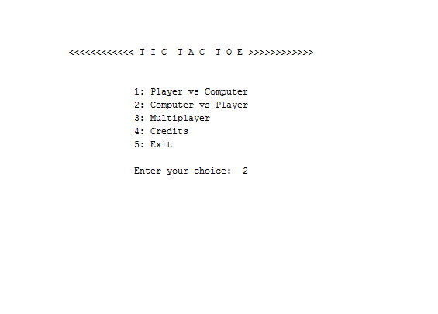
Screenshots of Computer vs Player

Slide 14
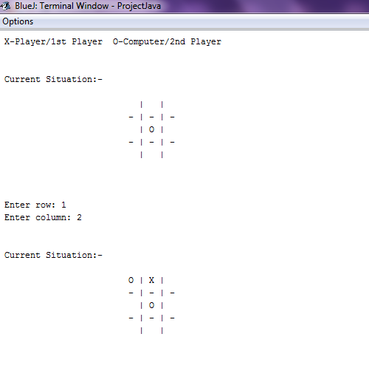
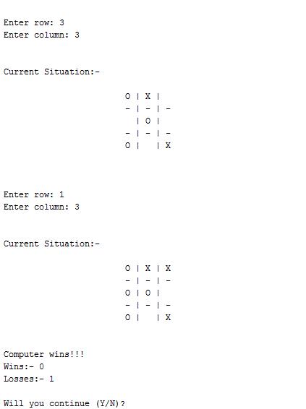

Slide 15
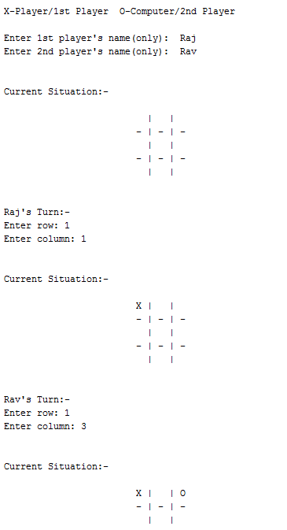
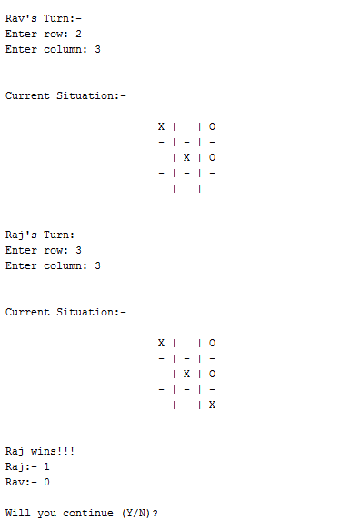
Screenshots of Multiplayer game
CODE
Back

Slide 16
Why Javascript?
JAVASCRIPT (JS) IS A DYNAMIC COMPUTER PROGRAMMING LANGUAGE. IT IS MOST COMMONLY USED AS PART OF WEB BROWSERS, WHOSE IMPLEMENTATIONS ALLOW CLIENT-SIDE SCRIPTS TO INTERACT WITH THE USER, CONTROL THE BROWSER, COMMUNICATE ASYNCHRONOUSLY, AND ALTER THE DOCUMENT CONTENT THAT IS DISPLAYED. IT IS ALSO BEING USED IN SERVER-SIDE PROGRAMMING, GAME DEVELOPMENT AND THE CREATION OF DESKTOP AND MOBILE APPLICATIONS.
Advantages over Java?
FOR JAVA BASED APPLICATIONS JDK(JAVA DEVELOPMENT KIT) IS USED FOR RUNNING THE PROGRAM. WHEREAS JAVASCRIPT IS A WEB LANGUAGE AND IS RUN ON THE WEB.
THE CODE IS SIMPLE AND THE INTERFACE IS USER FRIENDLY.

Slide 17
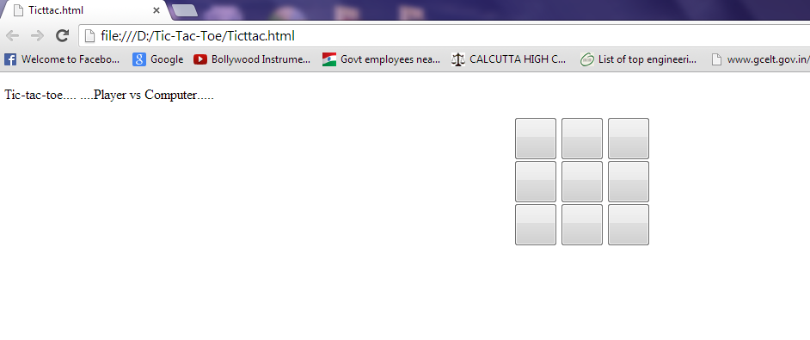
Player VS Computer

Slide 18
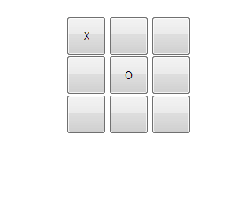
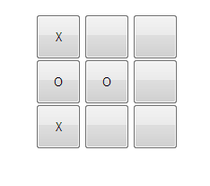
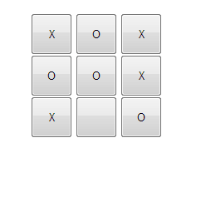
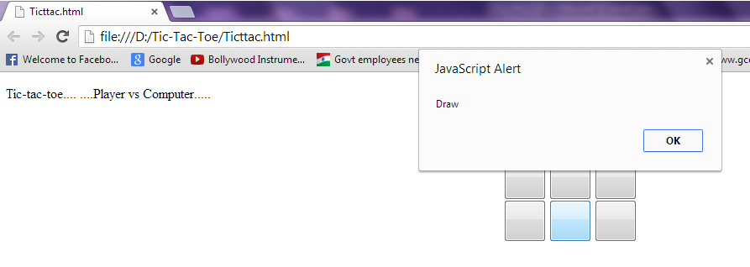

Slide 19
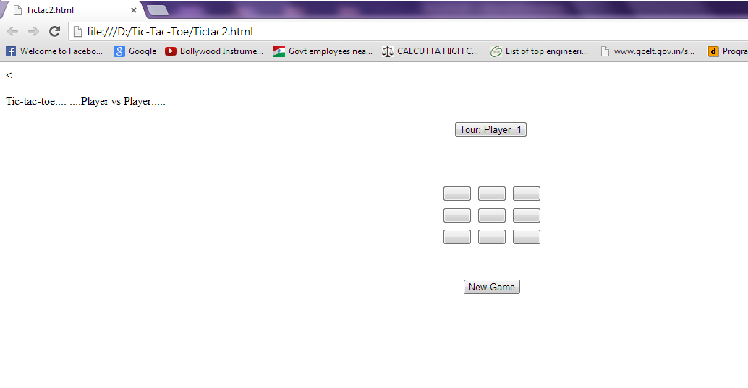
Multiplayer

Slide 20
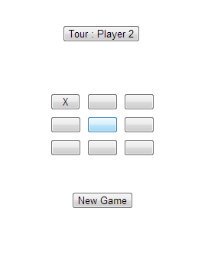
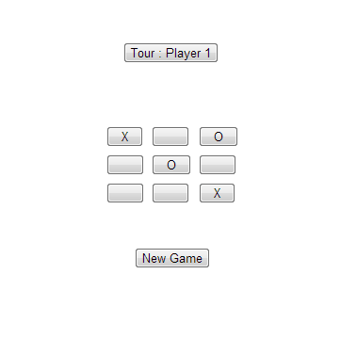
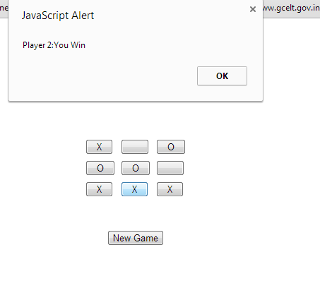
CODE
Back

Slide 21
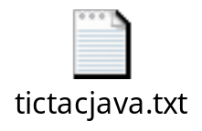


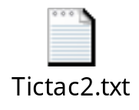

Codes :-
IN JAVA:-
IN JAVASCRIPT:-

Slide 22
References
HTTP://WWW.W3SCHOOLS.COM/JS/DEFAULT.ASP
HTTP://WWW.W3SCHOOLS.COM/HTML/DEFAULT.ASP

Slide 23
Thank You

